Slide 1
Training Provider Preparer Role User Guide
Updated 05/11/2018
Notes:
Welcome to the Lead Training Provider Preparer Role user guide!

Slide 2
Summary of Contents
Adding a Preparer to an existing Training Program
Preparer CDX registration
Making submissions as a Preparer
Reviewing Preparer submissions
Deactivating Preparer dashboards
Notes:
This user guide will walk through the following processes: adding a preparer to an existing Training Program, Preparer CDX registration, making submissions as a Preparer, reviewing Preparer submissions, and deactivating Preparer dashboards.

Slide 3
Adding a Preparer to an existing Training Program
Notes:
Preparers must be added by the Training Program Manager through the ‘Manage Preparers and Submissions’ tile on the Training Provider dashboard.

Slide 4
Adding a Preparer to an existing Training Program
Notes:
Click “Add Preparer.”

Slide 5
Adding a Preparer to an existing Training Program
Notes:
Enter the preparer’s name in the fields on the ‘Add a Preparer’ page.

Slide 6
Adding a Preparer to an existing Training Program
Notes:
When a preparer is added their name will show up in the Preparers table. After a preparer’s name is added to the Preparers table, the preparer is able to register for a CDX account through the Training Provider public site.

Slide 7
Preparer CDX Registration
Notes:
To begin the process of preparer CDX registration the preparer will have to navigate to the Training Provider public site located at https://cdx.epa.gov/XCDX/LeadTpCertification/Public.

Slide 8
Preparer CDX Registration
Notes:
Under ‘Access a Training Program as a Preparer,’ the preparer must enter the accreditation number associated with their training program.

Slide 9
Preparer CDX Registration
Notes:
After running the search, the training program’s information will appear and the preparer will be prompted to enter their name in the fields highlighted above. Note the preparer must enter the exact name that was entered into the Preparers table by the Training Program Manager.

Slide 10
Preparer CDX Registration
Notes:
The preparer will see this message if the entered name does not match the name saved by the Training Program Manager in the Preparers table.

Slide 11
Preparer CDX Registration
Notes:
If the name entered on the public site matches the name entered by the training program manager, the preparer will be brought to the CDX Log In/Register page. Preparers with an existing CDX account can log in and have their account associated with the training program. Preparers without an existing CDX account should click “Register” and register for a new account.

Slide 12
Preparer CDX Registration
Notes:
Users who are registering for the first time will have to complete all the fields on this page.

Slide 13
Preparer CDX Registration
Notes:
A validation email will be sent to the email address entered on the previous page.

Slide 14
Preparer CDX Registration
Notes:
The user will have to click the link in the message to validate their email address and complete registration.

Slide 15
Preparer Dashboard
Notes:
Clicking the link in the validation email will lead the user directly to the Lead Training Provider Preparer Dashboard. The preparer dashboard allows the preparer to fill out notifications and applications that will be sent to the Training Program Manager for review. Notifications and applications filled out by a preparer will need to be approved and signed by the Training Program Manager before submission to EPA.

Slide 16
Making submissions as a Preparer
Notes:
Notifications and applications are displayed the same way on the preparer dashboard, but a preparer will see a ‘Submit for Manager Review’ button in place of the ‘Sign’ button. Preparers are not able to enter payment information on applications that require payments (course accreditations, certificate replacement requests) – the program manager will have to enter payment information for these applications when these are reviewed.

Slide 17
Making submissions as a Preparer
Notes:
This confirmation message will generate when a preparer successfully submits an item for manager review.

Slide 18
Making submissions as a Preparer
Notes:
When a preparer makes a submission that is NOT a notification (people and facilities, course accreditations, certificate replacement requests, and info only amendments), the preparer’s access to the dashboard will be limited to the ‘View Pending Submissions’ tile. The preparer cannot generate further submissions until that submission is reviewed and signed or deleted.

Slide 19
Making submissions as a Preparer
Notes:
The preparer will see this message if they click on a disabled tile.

Slide 20
Making submissions as a Preparer
Notes:
The preparer can view all pending submissions by clicking the “View Pending Submissions” tile. The preparer can view and delete submissions on this page.

Slide 21
Reviewing Preparer submissions
Notes:
The Training Program Manager’s dashboard is also limited when the preparer submits a people and facilities amendment, course accreditation application, certificate replacement request, or info only amendment. The manager will need to sign these pending submissions by accessing them through the ‘Manage Preparers and Submissions’ tile.

Slide 22
Reviewing Preparer submissions
Notes:
All pending submissions are listed in the ‘Pending Submissions’ table on the ‘Preparer and Submission Management Home’ page. The training program manager can click “Review” to review and sign a submission or “Delete” to delete a submission. Pending submissions on this table are not sent to EPA until reviewed and signed by the training program manager.

Slide 23
Reviewing Preparer submissions
Notes:
Clicking “Review” on a notification submission brings the program manager to the ‘Review Pre-Training Notification’ page. Here the manager can review information submitted by the preparer and sign notifications to submit to EPA.

Slide 24
Reviewing Preparer submissions
Notes:
The training program manager will see this message to confirm that the notification has been successfully submitted.

Slide 25
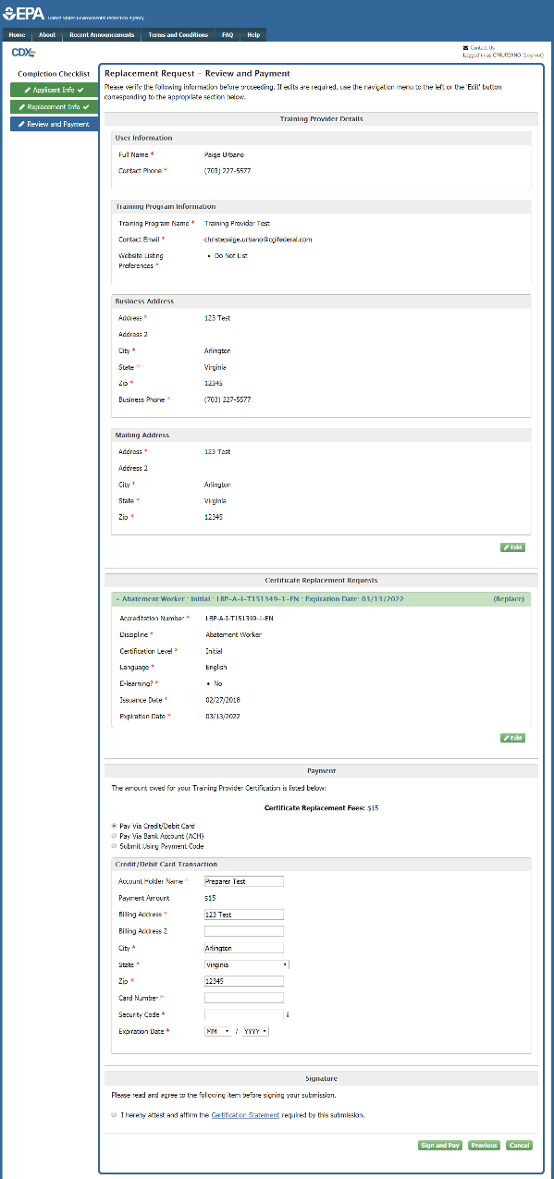
Reviewing Preparer submissions
Notes:
Submissions that require payment information will open to the ‘Review and Payment’ page. Here the manager can review information submitted by the preparer, add payment information, sign, and submit to EPA. Preparers do not have the ability to add payment information on the preparer dashboard, so payment information must always be added by the Training Program Manager during review.

Slide 26
Reviewing Preparer submissions
Notes:
The Training Program Manager will see this message to confirm that the application has been successfully submitted.

Slide 27
Deactivating Preparer dashboards
Notes:
If for any reason the Training Program Manager needs to disable a preparer’s dashboard, they can do this by clicking “Deactivate” next to the preparer’s name on the ‘Preparer and Submission Management Home’ page.

Slide 28
Deactivating Preparer dashboards
Notes:
A preparer whose dashboard has been deactivated will be redirected to the public site and see this message when they try to access their dashboard. A preparer’s dashboard may also be reactivated any time by clicking the “Reactivate” button next to their name on the ‘Preparer and Submission Management Home’ page.

